Slide 1


With Chris Partee Grace Olson & Hannah Allen
GT Bootcamp: Project #1
May 2, 2022

Slide 2

Analysis Purpose:
To explore the World Happiness Reports from 2015-2022
To further analyze additional variables that may influence happiness with a lens on 2022’s data:
Average income
Average sunshine
Life expectancy
Alcohol consumption

Slide 3

WHR Background
10th year of report
Gallup World Poll surveys from 2014 to 2021
Displays the extent to which each of six factors (levels of GDP, life expectancy, generosity, social support, freedom, and corruption) is estimated to contribute to making life evaluations higher in each country than in Dystopia. (Dystopia is a hypothetical country with values equal to the world's lowest national averages for each of the six factors).
Notes:
Image: https://worldhappiness.report/

Slide 4
World Happiness Report 2015-2022

Slide 5
Choropleth
Map Displays Happiest Countries Overtime

Slide 6
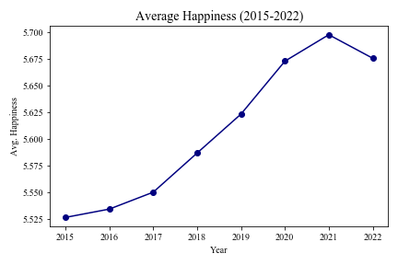
Average Happiness Trends Upward Overtime
Since 2015, average world happiness has had a positive trend upward, despite the pandemic and other world events.
Interestingly, this year, we see average world happiness decrease slightly.
Notes:
Whoever is presenting the slides to have happiness over time to have jupyter notebook open

Slide 7
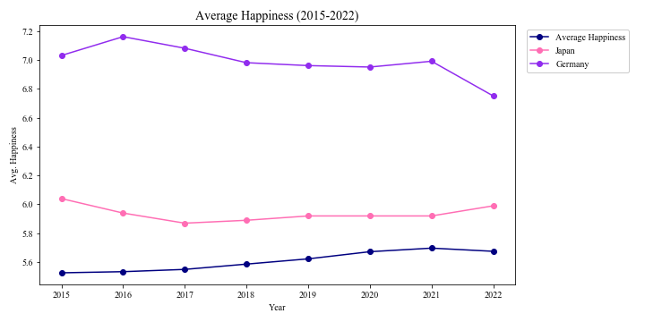
Your Turn!
Pick 2 Countries to Compare Happiness Overtime
→ We chose to compare Japan and Germany vs average happiness for the time frame.
→ Our code allows the user to enter any two countries to compare and outputs the line chart displayed to the right.
Notes:
Whoever is presenting the slides to have happiness over time to have jupyter notebook open

Slide 8
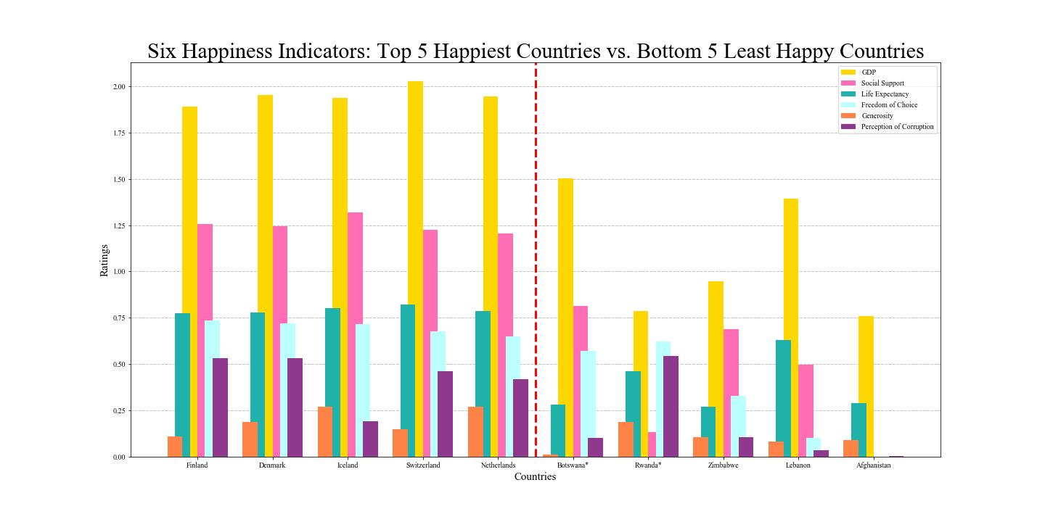
Comparing Happiness Indicators from WHR

Slide 9
2a
Our Questions

Slide 10
Q: Are countries with higher average incomes happier?
“...higher incomes may still have potential to improve people’s day-to-day well-being, rather than having already reached a plateau for many people in wealthy countries.”- Forbes (1)

Slide 11
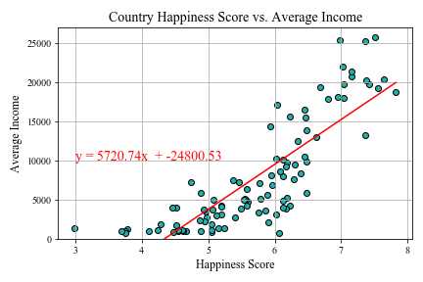
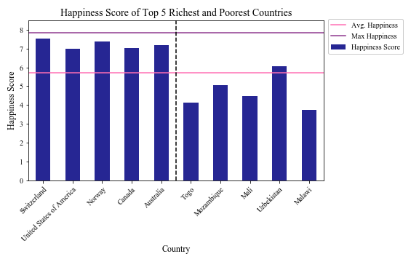
Higher Average Income Countries Appear Happier
Outside factors with potential impact on average income, not considered in our dataset:
Countries with higher average income may have higher economic growth, lower inflation, faster population growth, etc.

Slide 12
Q: Does the weather of a country (avg. sunshine) influence happiness?
“People instinctively believe that better weather results in better moods” -psychology today (2)

Slide 13
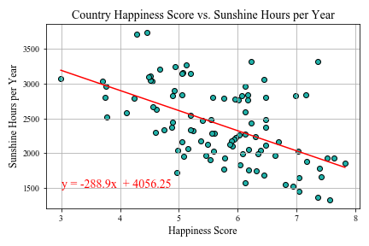
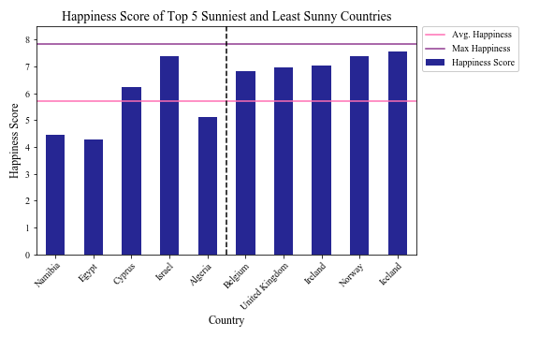
More Sunshine Does Not Mean Countries are Happier
Outside factors with potential impact on a country’s weather, not considered in our dataset:
Other factors influencing a country’s weather may include cloudiness, humidity, rainfall, temperature, etc.

Slide 14
Q: Are countries with longer life expectancies happier?
“A new study has found that those in better moods (happier) were 35% less likely to die in the next 5 years when taking their life situations into account.”- Science. Org (3)

Slide 15
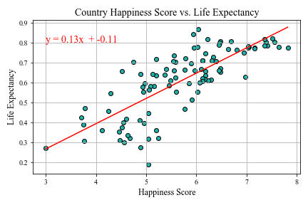
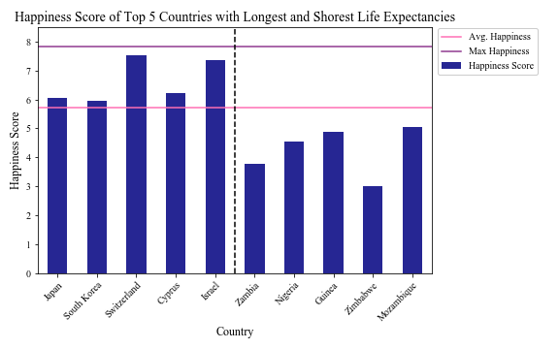
Longer Life Expectancy May Suggest Happier Countries
Outside factors with potential impact on life expectancy, not considered in our dataset:
Countries with shorter life expectancy may be heavily populated, with a lot of pollution, have less access to health care, have higher violence rates, be war-torn, etc.
Notes:
Life expectancy has a weak positive correlation with happiness
Top 5 countries with the longest life expectancy are above avg. world happiness while bottom 5 countries are well below avg. world happiness.

Slide 16
Q: Does alcohol consumption influence happiness?
“ In conclusion, while iPhone users are happier at the moment of drinking, there are only small overspills to other moments, and among the wider population, changing drinking levels across several years are not associated with changing life satisfaction.” - Study by Ben Baumberg Geiger 1, George MacKerron (4)

Slide 17
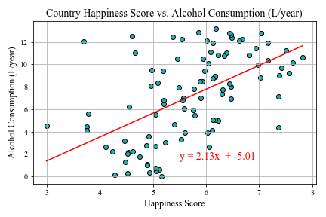
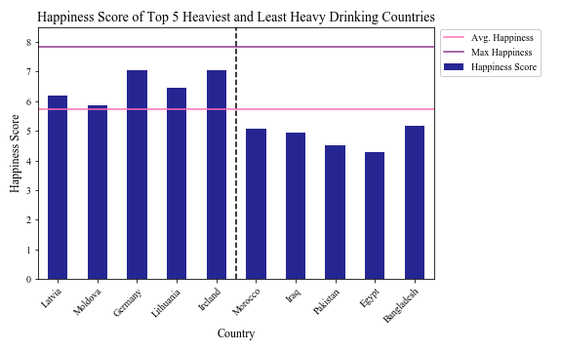
Alcohol Consumption Does Not Influence Happiness
Outside factors with potential impact on alcohol consumption, not considered in our dataset:
Countries may rank low in alcohol consumption for religious reasons or low societal acceptance, etc.

Slide 18
a
sd
Conclusions, Limitations, & Considerations

Slide 19
Which of these indicators influences happiness the most?

Slide 20
Average Income and Life Expectancy have the Highest R-Square Values
0.698
0.294
0.608
0.309
Avg. Income R-Square Value
Annual Sunshine R-Square Value
Life Expectancy R-Square Value
Alcohol Consumption R-Square Value

Slide 21
Based on the R-square Values and Indicator Variation with Happiness, we Conclude Average Income is the Best Happiness Indicator of the Variables Selected.
Average income has the strongest correlation with happiness score.
Life expectancy also has a strong correlation with happiness scores
However, as shown below, the relationship life expectancy and happiness has more variability

Slide 22
Limitations
Overall Analysis Limitations:
World Happiness dataset only comes from countries willing to participate.
Without the ability to conduct multiple regression test, we were not able to statistically prove that income was the strongest factor.
We were reliant on using R-Square Values.
Unable to code the maps to to be interactive to cycle through the years
Dataset Limitations:
In our attempt to compare happiness to weather, it was difficult to find a complete historical dataset to incorporate all weather factors that can affect mood (rainfall, cloudiness, temperature- historical weather APIs cost money)
Lack of datasets that could look further into the impact of corruption.
Lack of datasets having the same variables to further make comparisons:
ex. Male vs. Female

Slide 23
Future considerations
Research other happiness indicators:
Job satisfaction
Population density
Rural vs. Urban living
Loneliness
Disease burden
Education level
Type of Government
Compare:
Cost of living to happiness
Healthy habits to life expectancy, happiness
Other weather factors to happiness
Social drinking vs. Problem drinking to happiness

Slide 24
THANK YOU!!

Slide 25
Data Sets
World happiness dataset 2022:
https://www.kaggle.com/datasets/ajaypalsinghlo/world-happiness-report-2022
World happiness dataset 2015-2022
https://www.kaggle.com/datasets/mathurinache/world-happiness-report?select=2017.csv
Median Income by Country:
https://worldpopulationreview.com/country-rankings/median-income-by-country
Sunshine Hours:
https://www.kaggle.com/datasets/prasertk/sunshine-duration-by-city
Alcohol Consumption by Country:
https://worldpopulationreview.com/country-rankings/alcohol-consumption-by-country

